Slide 1

Lesson 01
APIs & JSON

Slide 2
API
An Application Programming Interface (API) is an interface or communication protocol between different parts of a computer program intended to simplify the implementation and maintenance of software.
An API may be for a web-based system, operating system, database system, computer hardware, or software library

Slide 3
JSON
JavaScript Object Notation is an open-standard file format or data interchange format that uses human-readable text to transmit data objects consisting of attribute–value pairs and array data types. It is a very common data format, with a diverse range of applications.

Slide 4
JSON
{ }. = JSON Object
[ ]. = JSON Array
“key” : “value” //String
“key” : value //numerical values

Slide 5

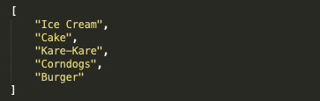



JSON

Slide 6
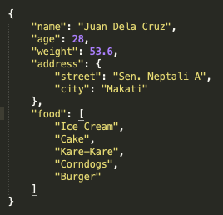
JSON

Slide 7
RESTful API
A RESTful API is an application program interface (API) that uses HTTP requests to GET, PUT, POST and DELETE data.

Slide 8
Hands-on

Slide 9
What you will learn
Using a simple REST API (GET)
Parsing a JSON.
Some error handling techniques

Slide 10

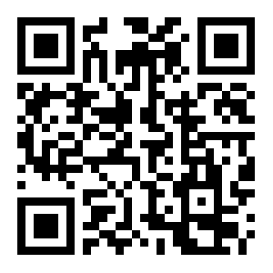
Have a good day!
https://github.com/JcDelaCueva/nu-calamba-lessons

